Slide 1

John ILIADIS
IT Infrastructure Director, TEIRESIAS S.A. Audit Chair, ISC2 Hellenic Chapter
Same Seat,
Different Day
John ILIADIS
Audit Chair, ISC2 Hellenic Chapter
IT Infrastructure Director, TEIRESIAS S.A.
Enterprise CyberDefense: a Groundhog Day Cycle

Slide 2

At a glance
What Groundhog Day?
How do I break into it?
How do I break out of it?
How do I survive within it?
Final Remark

Slide 3

What Groundhog Day?

Slide 4

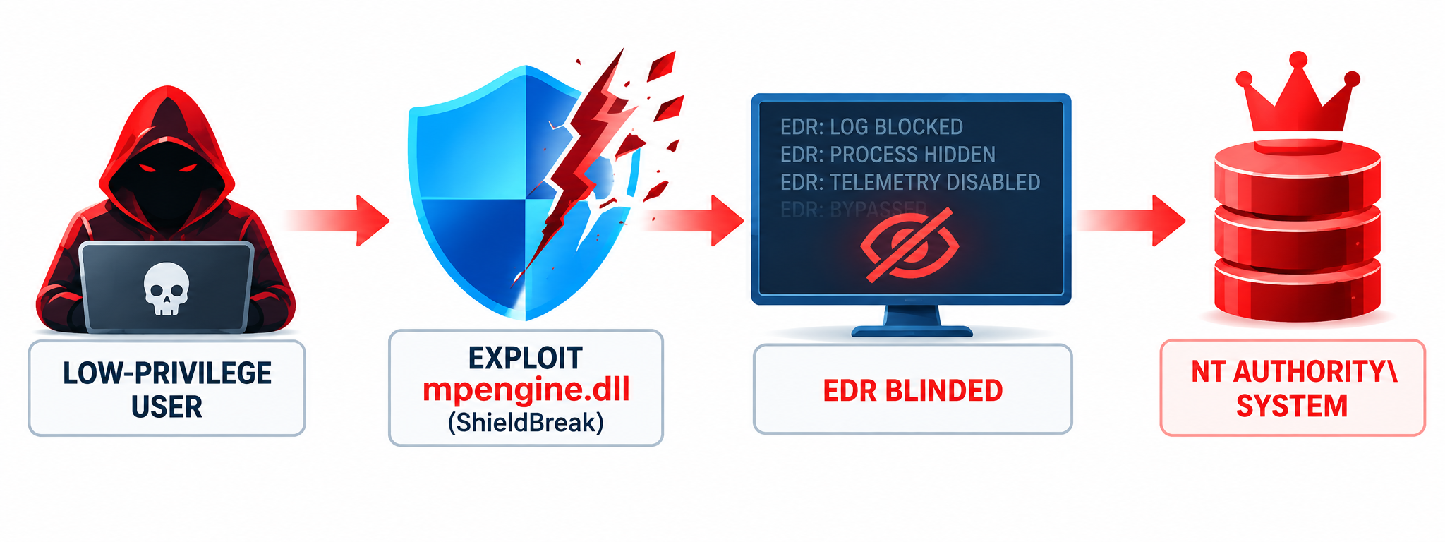
Endpoint Controls: Exploited to Blind Us
PILLAR 1
PILLAR 2
ShieldBreak — CVE-2026-69414
Signed-Driver Trust Abuse
A local elevation-of-privilege flaw in Microsoft Defender’s Malware Protection Engine can move a low-privilege attacker to SYSTEM.
GodDamn ransomware used the malicious Microsoft-signed PoisonX driver to disable endpoint defenses. Fox Tempest separately showed how fraudulent signing can industrialize the same trust-chain weakness.

Slide 5

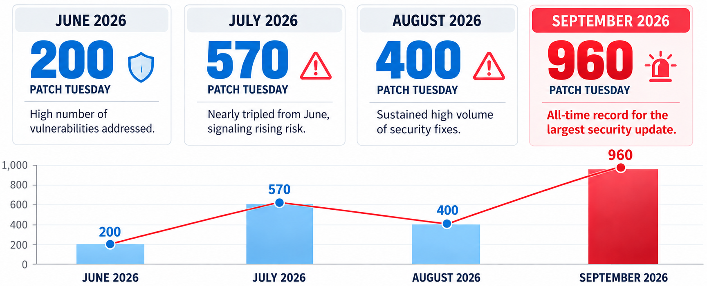
Operational Triage is Collapsing Under Historic Volume
Sources: https://www.bleepingcomputer.com/tag/patch-tuesday/

Slide 6

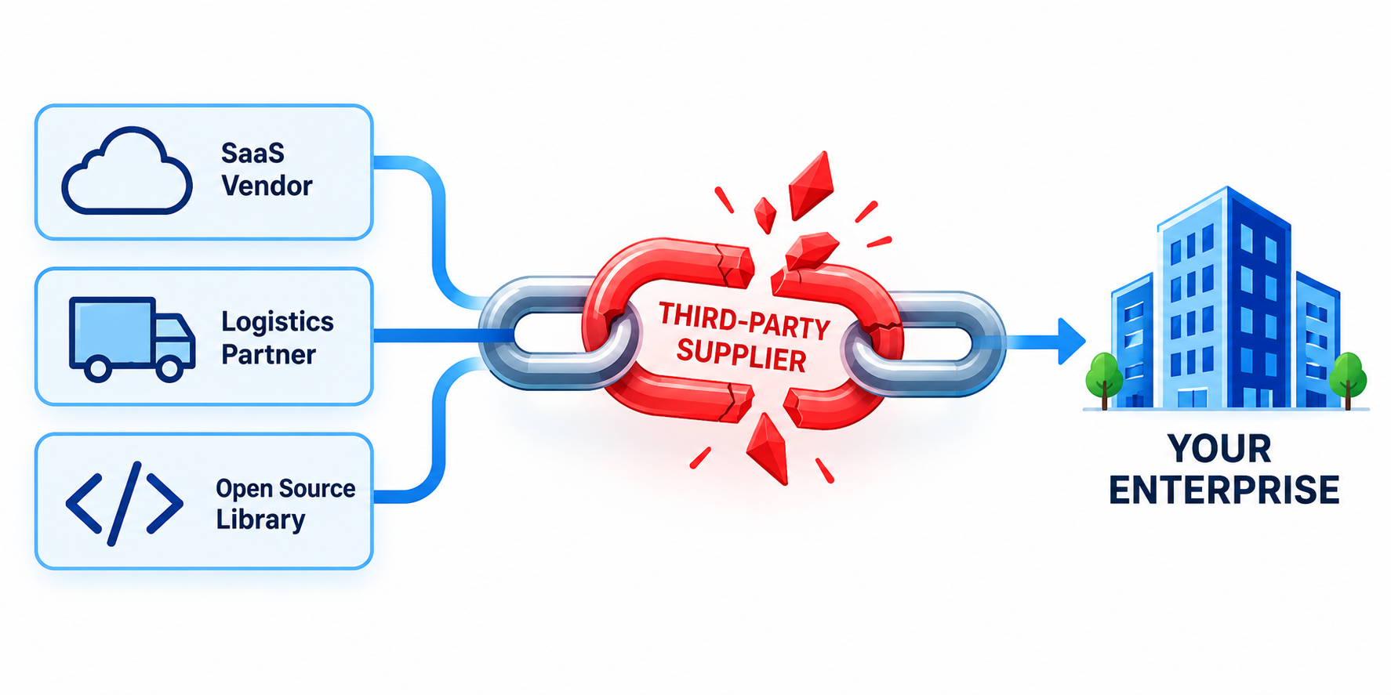
Perimeter Nullified When Suppliers Failed
01
THIRD-PARTY HR SaaS
TinyPulse / Nintendo of America
Attackers compromised TinyPulse, the employee-survey service used inside Nintendo of America. Survey content compromised.
02
FULFILLMENT PARTNER
CEVA Logistics Cascade
A cyber intrusion disrupted contract-logistics operations across eight European warehouses. Delivery data flowed outward to downstream customers.
03
OPEN-SOURCE DEPENDENCY
A compromised maintainer token pushed malicious code into Keyv and Cacheable; legitimate release workflows published it with valid provenance. A credential stealer harvested various secrets.
ChainDrop npm Poisoning

Slide 7

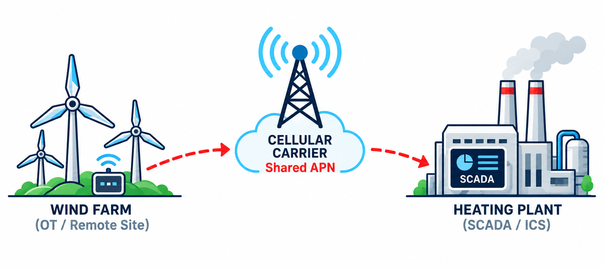
Bypassing Firewalls via Shared APNs
ZONE A / DISTRIBUTED ENERGY + CARRIER TRANSPORT
ZONE B / CHP INDUSTRIAL CONTROL
INITIAL FOOTHOLD
TRUSTED TRANSPORT
OT ENTRY
PHYSICAL PROCESS
Wind-farm network
Private APN
M2M PIVOT
WAGO controller
CHP operations
Compromised remote environment
Client-to-client traffic allowed
NO ISOLATION
Reachable through shared APN
Turbine + water treatment stopped
PERIMETER FIREWALL
BYPASSED
REAL-WORLD EFFECT
Short operational outage • ~50,000 residents served • no customer heat or power interruption
CONTROL GAP
A private APN is segmentation only when client isolation and endpoint trust are enforced.

Slide 8


Physical access invalidating BitLocker protection
6.8
An unauthorized attacker with physical access can bypass BitLocker. The published vector requires no privileges or user interaction.
CVSS
TARGET SYSTEM
Windows BitLocker
CVE-2026-50507
POLICY IMPACT
Consider adding TPM+PIN to reduce exposure to attack path.

Slide 9

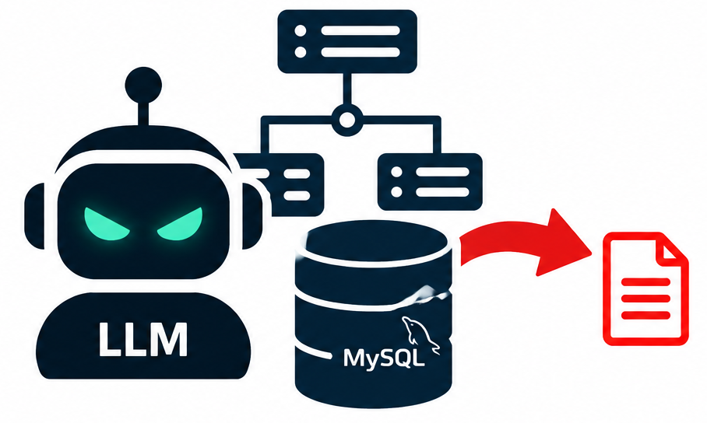
JADEPUFFER EXECUTION PROFILE
JadePuffer turns post-exploitation into a zero-click pipeline
Campaign engine: LLM-orchestrated intrusion
Live autonomous ransomware campaign driven natively by LLM.
Topology → machine-readable
Once inside, the LLM reads and evaluates internal network topology.
High-value IP auto-selected
LLM locates internal production MySQL servers, parses schemas, identifies high-value data and selectively exfiltrates it.
EXPLOIT → MAP → SELECT → EXFILTRATE HUMAN COMMANDS: 0

Slide 10


Sunday is for rest; is it?
capturing the week’s lessons while they are still fresh
carrying one clear improvement into Monday
leaving room to recharge and stay close to friends and family
…until SOC raises an incident demanding all-hands on deck

Slide 11
Moving on…
What Groundhog Day?
How do I break into it?
How do I break out of it?
How do I survive within it?
Final Remark

Slide 12
How can I break into Groundhog Day?
entry level position?
…just ask

Slide 13
Moving on…
What Groundhog Day?
How do I break into it?
How do I break out of it?
How do I survive within it?
Final Remark

Slide 14
How can I break out of Groundhog Day?
two words:
you cannot

Slide 15
Moving on…
What Groundhog Day?
How do I break into it?
How do I break out of it?
How do I survive within it?
Final Remark

Slide 16
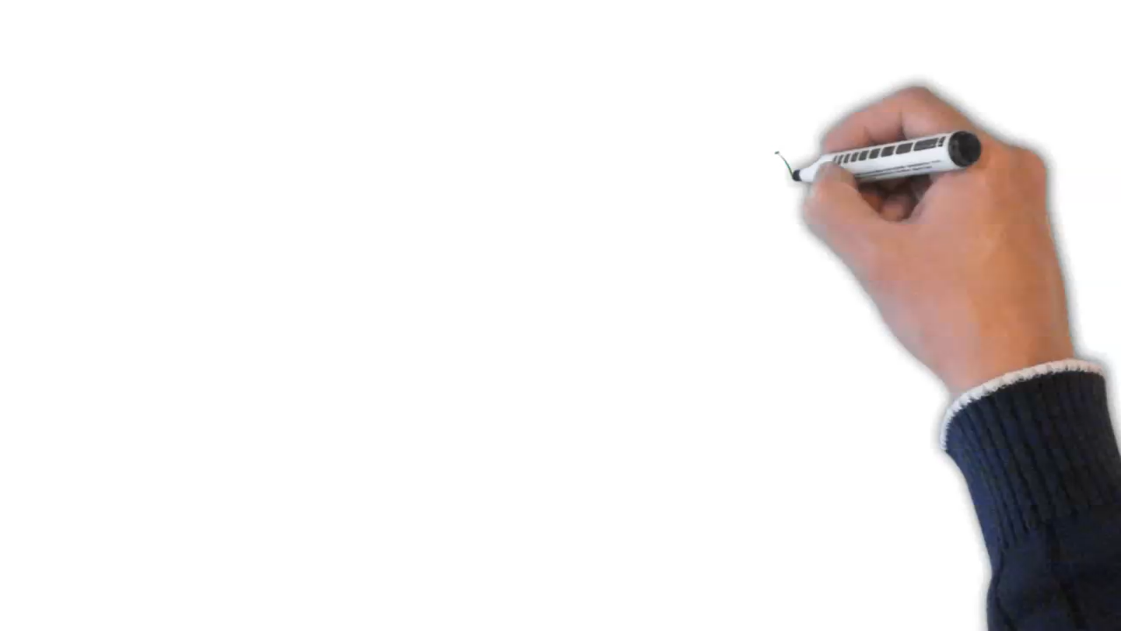
5-step process to survive

Slide 17
5-step process to survive
01
Talk the talk
02
Walk the talk
03
Prioritize
04
It’s all about People!
05
Make peace

Slide 18

5-step process to survive
Step 1: Talk the talk – Ye olden way (qualitative)

Slide 19

5-step process to survive
Step 1: Talk the talk – Business language (quantitative)

Slide 20
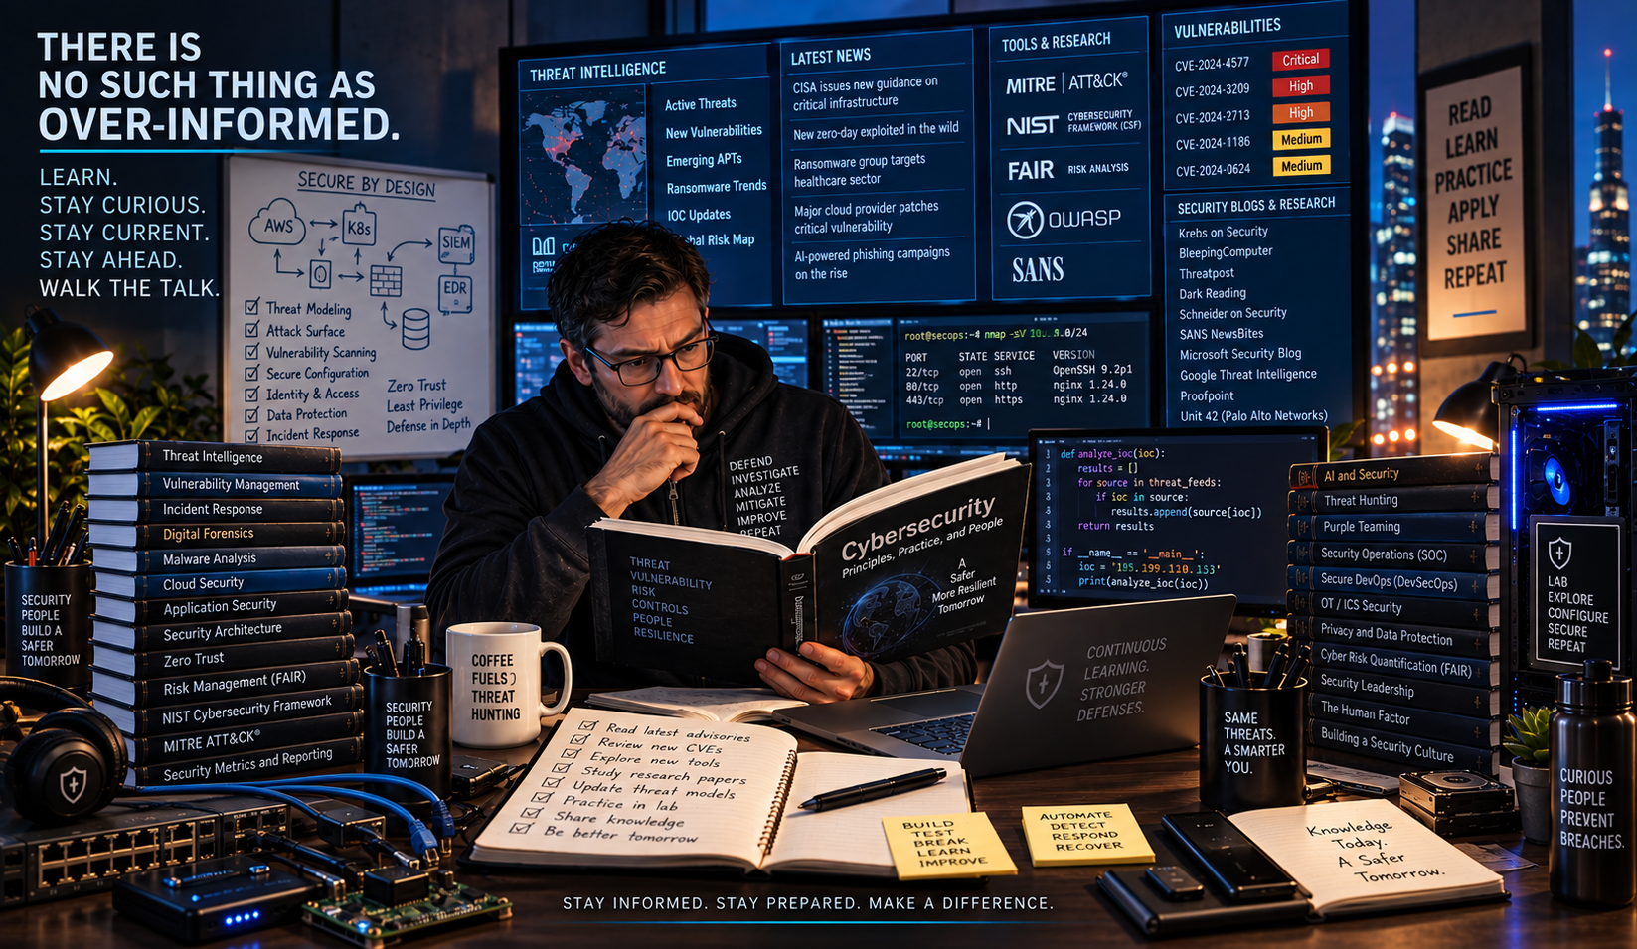
5-step process to survive
Step 2: Walk the talk

Slide 21

5-step process to survive
Step 3: Prioritize

Slide 22

5-step process to survive
Step 4: It’s all about People, Part1
Accidental Manager? Do stg.
  Easy: Management Models (e.g. Situational Leadership, Maslow)
  Easier said than done: Coaching (e.g. Coaching with Compassion)
Communication: persuading ≠ deceiving.
  Use loss aversion, sunk cost effect, active choice, framing

Slide 23

5-step process to survive
Step 4: It’s all about People, Part2
The old training joke:
  What if we train them and they leave?
  What if we don’t train them and they stay?
Diversity: reduces groupthink, creates confidence gap
Overcoming daily challenges: a path to arrogance?
  Memento mori…*
*In ancient Rome, a servant reportedly whispered the phrase to victorious generals
during a triumph to remind them of their mortality and prevent hubris

Slide 24

5-step process to survive
Step 5: Make peace with it

Slide 25
Moving on…
What Groundhog Day?
How can I break out of it?
How can I survive within it?
Final Remark

Slide 26

Final Remark
Same Seat. Different Day.
Never the Same Challenge.

